Slide 1
INTERMEDIATE FREQUENCY
&
IF AMPLIFIERS

Slide 2
PRESENTED BY
MD. RIFAT E NOOR
ID - 11809010
DEPT. OF ICT
COMILLA UNIVERSITY
PRESENTED TO
MD. IMRAN HOSSAIN
ASSISTANT PROFFESSOR
DEPT. OF ICT
COMILLA UNIVERSITY

Slide 3
Let’s Start

Slide 4
INTERMEDIATE FREQUENCY
&
IF AMPLIFIERS
Definition on Intermediate frequency
Needs of Intermediate frequency
Choice of Intermediating Frequency
Intermediating Frequency Amplifiers

Slide 5
Intermediate Frequency (IF)
Definition
An Intermediate frequency is a relatively low frequency to which a signal is converted before demodulation in heterodyne reception.
It is created by mixing the carrier signal with a local oscillator

Slide 6
Antenna
Filter
Detector
A
Device
Fig: Old Radio Idea

Slide 7
RL Mixer
½{Cos(A+B)+Cos(A-B)}
Cos(A)
R
I
L
Cos(B)

Slide 8
Antenna
Filter
RF Amplifier
RL Mixer
IF Amplifier
Demodulation
Local oscillator Generator
Fig: New Radio Idea

Slide 9
Choice of Frequency
Range : 300 Hz to 10MHz (WHO)
The following are the major factors influencing the choice of the intermediate frequency in any particular system.

Slide 10
1. If the intermediate frequency is too high, poor selectivity and poor adjacent channel rejection result
2. A high value of intermediate frequency increases tracking difficulties.
3. As the intermediate frequency is lowered, image-frequency rejection becomes poorer.

Slide 11
4. A very low intermediate frequency can make the selectivity too sharp, cutting off the sidebands.
5. The intermediate frequency must not fall within the tuning range of the receiver

Slide 12
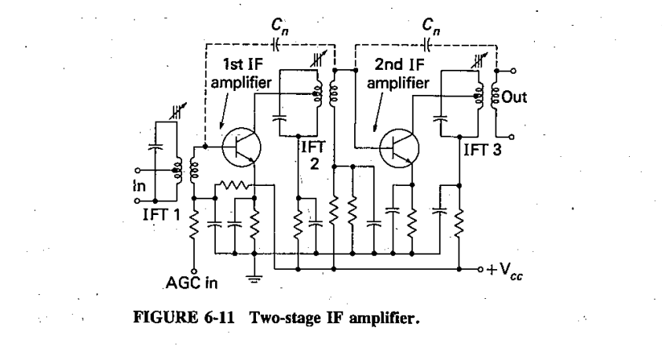
Intermediate-frequency amplifiers

Slide 13
The IF amplifier is a fixed-frequency amplifier, with the very important function of rejecting adjacent unwanted frequencies. It should have a frequency response with steep skirts. When the desire flat-topped response is added, the resulting recipe is for a double-tuned or stagger-tuned amplifier.
Whereas FET and integrated circuit IF amplifiers generally are (and vacuum-tube ones always were) double-tuned at the input and at the output, bipolar transistor amplifiers often are single-tuned. A typical bipolar IF amplifier for a domestic receiver is shown in the Figure

Slide 14
It is seen to be a two-stage amplifier, with all IF transformers single tuned. This departure from a single-stage, double-tuned amplifier is for the sake of extra gain, and receiver sensitivity.
The reason is that greater gain is achieved in this way because of the need for tapping coils in tuned circuits. This tapping may be required to obtain maximum power transfer and a reduction of tuned circuit loading by the transistor.

Slide 15
Since transistor impedances may be low, tapping is employed, together with somewhat lower inductances than would have been used with tube circuits. If a double-tuned transformer were used, both sides of it might have to be tapped, rather than just one side as with a single-tuned transformer. Thus a reduction in gain would result.
Note also that neutralization may have to be used in the transistor IF amplifier, depending on the frequency and the type of transistor employed

Slide 16
When double tuning is used, the coefficient of coupling varies from 0.8 times critical to critical, over coupling is not normally used without a special reason. Finally, . the IF transformers are often -all made identical so as to be interchangeable.

Slide 17
Thanks!
Any questions?

